Slide 1
Machine Learning CS F464
Dr. Pranav M. Pawar

Slide 2
Contents
Support Vector Machine (SVM)
Linear SVM
Example
Non Linear SVM
Example

Slide 3
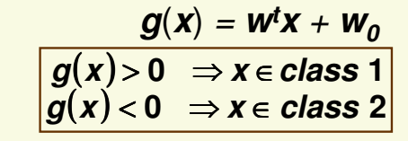
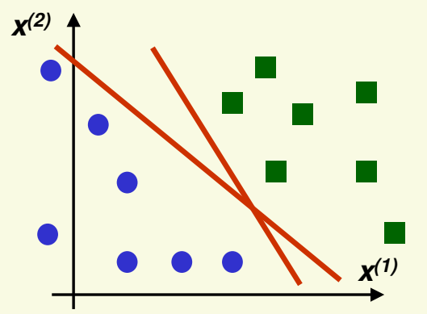
SVM: Introduction
A discriminant function is linear if it can be written as,

Slide 4
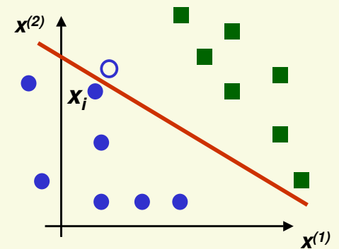
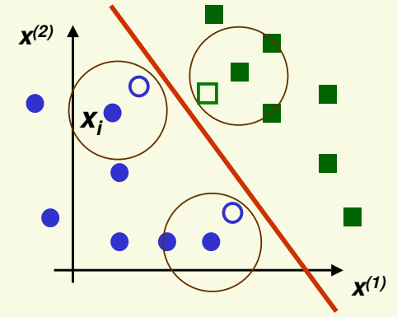
SVM: Introduction
If we see new sample close to sample i, it is likely to be on the wrong side of the hyperplane
Hyperplane as far as possible from any sample.
New samples close to the old samples will be classified correctly

Slide 5
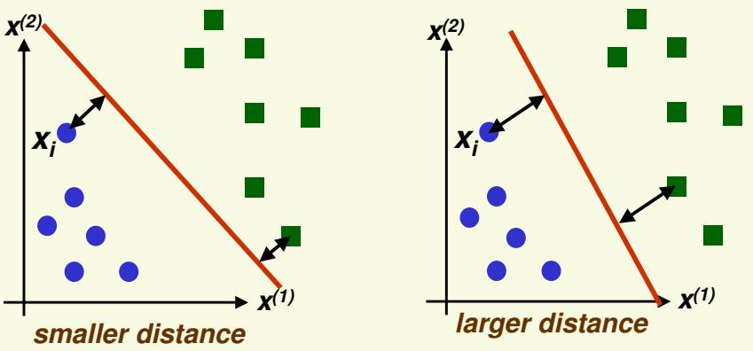
SVM: Introduction
Idea of SVM => maximize distance to the closest example
For the optimal hyperplane
Distance to the closest negative example = Distance to the closest positive example

Slide 6
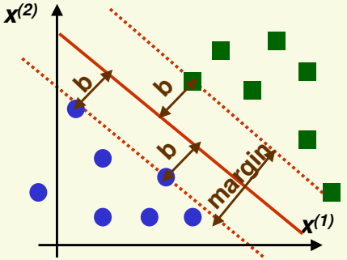
SVM: Linearly Separable
Maximize the margin.
Margin is twice the absolute value of distance b of the closest example to the separating hyperplane.
Support vectors are the samples closest to the separating hyperplane

Slide 7
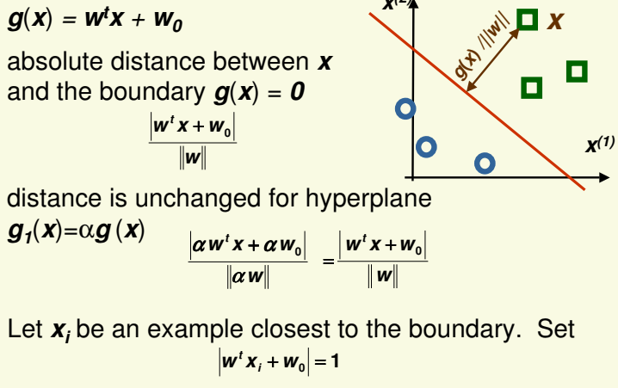
SVM: Margin (1)

Slide 8
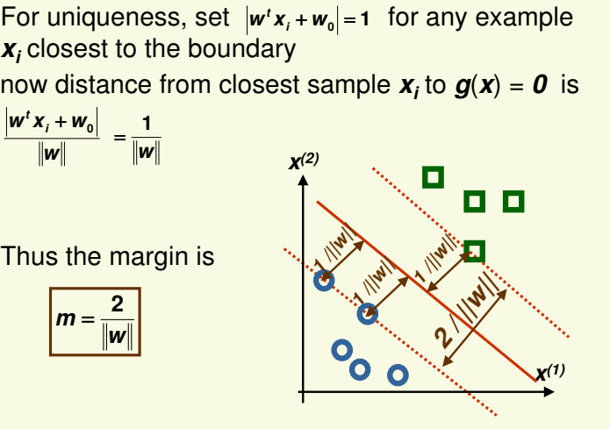
SVM: Margin (2)

Slide 9



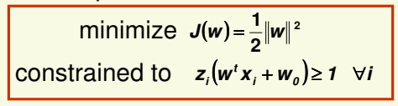
SVM: Optimal Hyperplane
Maximize margin,
subject to constraints,
Let,
According to previous consideration,

Slide 10


SVM Example (1)
Suppose we are given the following positively labelled data points,
and the following negatively labelled data points
Find simple SVM which will clearly discriminate the data points into two classes.

Slide 11
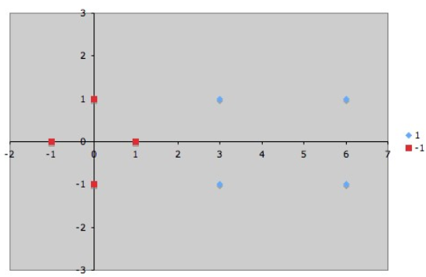
SVM Example (2)
Step1: Draw the data points

Slide 12

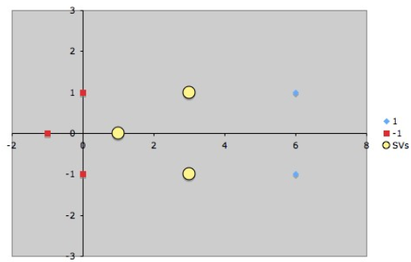
SVM Example (3)
Step 2: Find support vectors
By observation three support vectors are,

Slide 13
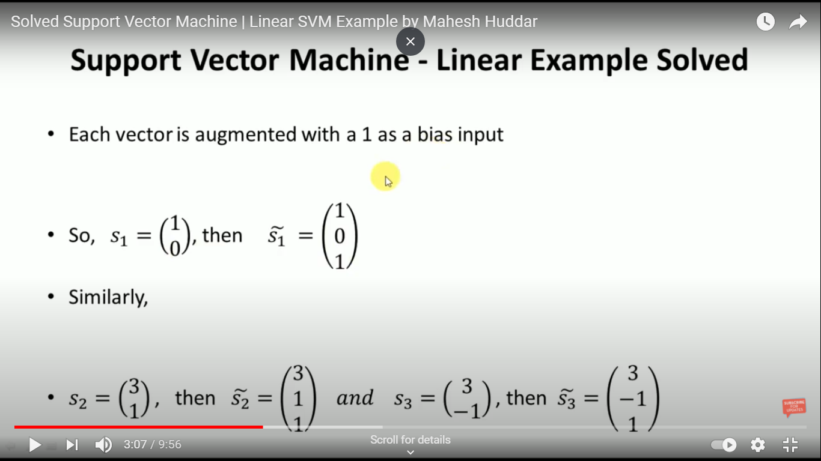
SVM Example (4)
Step 3: Augment each vector with bias input 1.

Slide 14
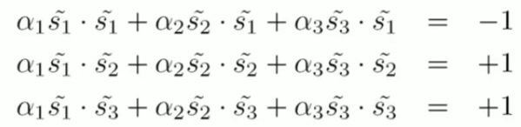
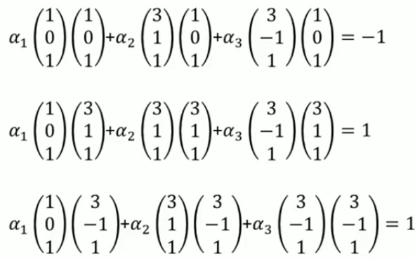
SVM Example (5)
Step 5: Find values of α.

Slide 15
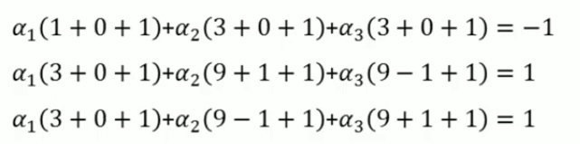
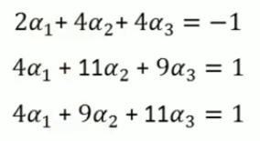
SVM Example (6)
α₁= -3.5, α₂= 0.75, α₃= 0.75

Slide 16
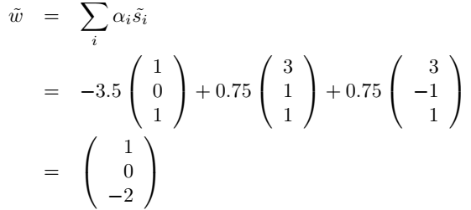
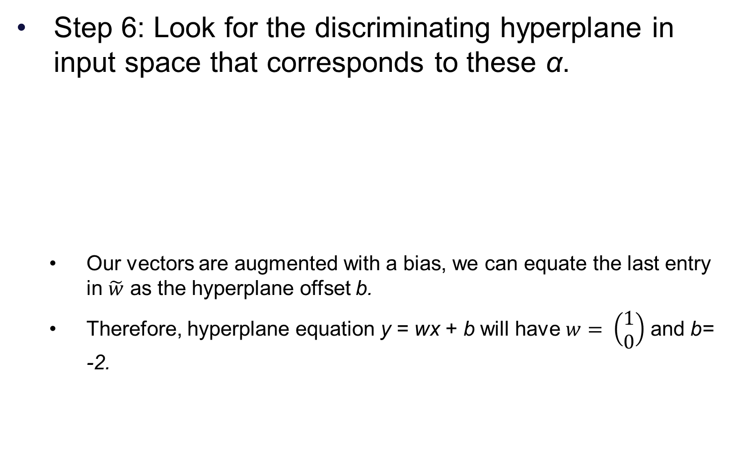
SVM Example (6)
Step 6: Look for the discriminating hyperplane in input space that corresponds to these α.
Our vectors are augmented with a bias, we can equate the last entry in $\tilde{w}$ as the hyperplane offset b.
Therefore, hyperplane equation y = wx + b will have $w= \left(\begin{matrix}1 \\ 0\end{matrix}\right)$ and b= -2.

Slide 17
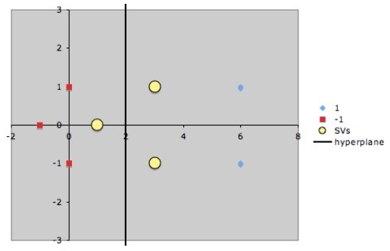
SVM Example (7)

Slide 18
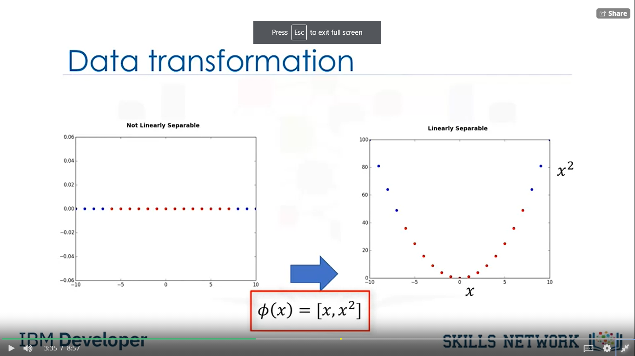
SVM: Non-linear
One dimensional space,
not linearly separable.
Lift to two dimensional
space with Փ(x)=(x,x²).

Slide 19
SVM: Non-linear
Can use any linear classifier after lifting data into a higher dimensional space. However we will have to deal with the “curse of dimensionality”
Poor generalization to test data
Computationally expensive
SVM avoids the “curse of dimensionality” problems by
Enforcing largest margin permits good generalization
Computation in the higher dimensional case is performed only implicitly through the use of kernel functions

Slide 20

SVM: Non-linear
Why use kernels?
Make non-separable problem separable.
Map data into better representational space
Common kernels
Linear
Polynomial Kernel
Gaussian Kernel
RBF Kernel

Slide 21


SVM Example 2 (1)
Suppose we are given the following positively labelled data points,
and the following negatively labelled data points
Find simple SVM which will clearly discriminate the data points into two classes.

Slide 22
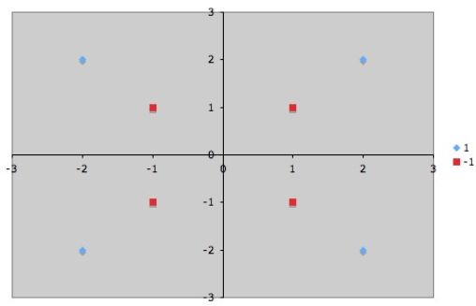
SVM Example 2 (2)
Step1: Draw the data points

Slide 23
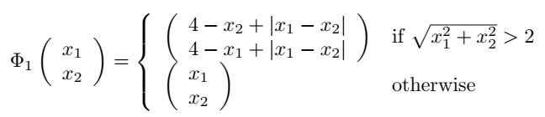
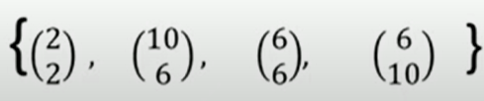

SVM Example 2 (3)
Step 2: Consider a mapping function. Here, we will consider our mapping function is,
According to the mapping function new values are,
Positive samples
Negative samples

Slide 24
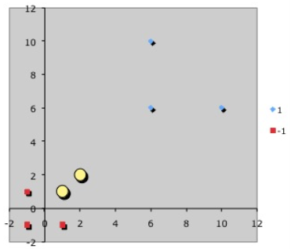

SVM Example 2 (4)
Step 3: Draw new samples and identify support vectors
Support vectors are,

Slide 25
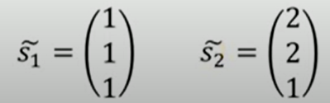
SVM Example 2 (5)
Step 4: Augment each vector with bias input 1.

Slide 26
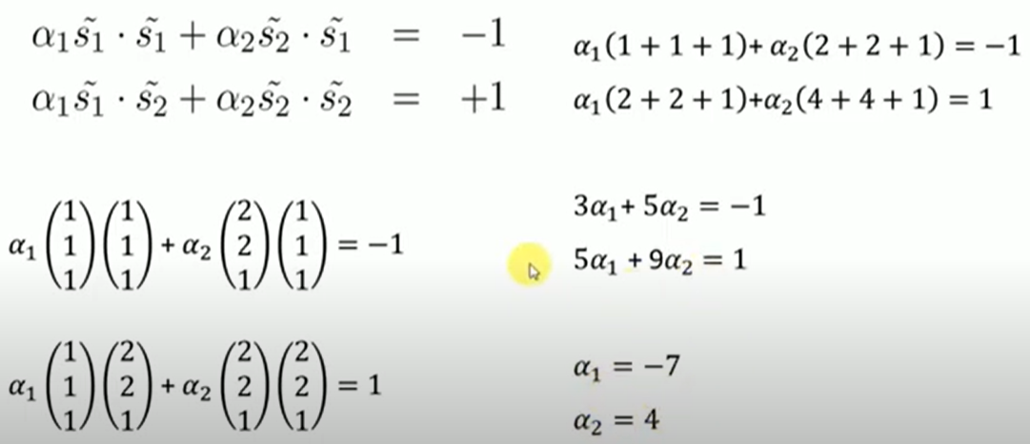
SVM Example 2 (7)
Step 5: For given support vectors find values of α.

Slide 27

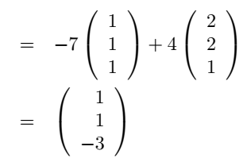

SVM Example 2 (8)
Step 6: Look for the discriminating hyperplane in input space that corresponds to these α.
Our vectors are augmented with a bias, we can equate the last entry in $\tilde{w}$ as the hyperplane offset b.
Therefore, hyperplane equation y = wx + b will have $w= \left(\begin{matrix}1 \\ 1\end{matrix}\right)$ and b= -3.

Slide 28
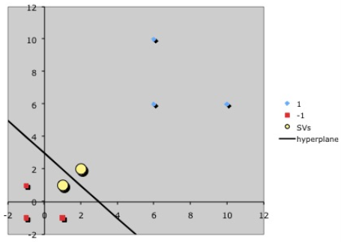
SVM Example 2 (9)

Slide 29
Advantages and Disadvantages
Advantages
Accurate in high dimensional space.
Different kernel functions for different decision problem.
Memory efficient: Use of support vectors for deciding decision boundaries.
Disadvantages
Prone to over-fitting
No probability estimation
Efficient for average or small datasets
Bad performance if features > samples.

Slide 30
Sources
Chapter 8, Christopher M Bishop: Pattern Recognition & Machine Leaning, 2006 Springer.
“Machine learning with Python course”, IBM.
https://www.csd.uwo.ca/~oveksler/Courses/CS434a_541a/
https://data-flair.training/blogs/svm-kernel-functions
http://axon.cs.byu.edu/Dan/678/miscellaneous/SVM.example.pdf
https://web.iitd.ac.in/~bspanda/KNN%20presentation.pdf
https://www.youtube.com/watch?v=Vk9lGGODaJA
https://www.youtube.com/watch?v=3EQw8awLQJ4

Slide 31
Thank You!

